Slide 1
Consensus & Variant Calling Dr. David Bibby, Genomics and Clinical Virology, 21st March 2024

Slide 2
Overview
Consensus & Variant – what are they?
How to build a consensus and define variants
What can be done with variant analysis - examples
Features: Drug resistance, epitopes, species/strain identification
Phyletics: Linkage, Dual infections, Transmission, Quasispecies reconstruction
Technical pitfalls - examples
Virus – Laboratory – Bioinformatics
Validation, validation, validation
Reproducibility
Standardised materials
EQA schemes
Clinical validation?

Slide 3
Consensus and Variant
Consensus: "The sequence of the most frequent nucleotides at each position”
Variants: “Differences between a test sequence and a reference”
Viruses often exist in populations of related sequences, i.e.‘quasi-species’
A consensus of a viral sequence may often contain mixed bases, incorporating the variants above a set frequency
e.g. 15-20% to mimic Sanger detection

Slide 4

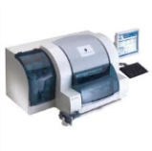
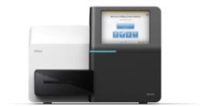
Target-specific Amplification
“Amplicon”
Using gene-specific primers
Target-specific Enrichment
Library Preparation
Sequence capture using virus-specific probe baits
Amplification
Fragmentation
Adapter ligation
LM-PCR
Quality control
Library pooling
Sample
Nucleic Acid Extraction
Sequencing
Library Preparation
Target-specific Enrichment
“Metagenomic”
Fragmentation
Adapter ligation
LM-PCR
Quality control
Library pooling
Sequence capture using virus-specific probe baits
LM-PCR
Data Analysis
Raw data quality checks
Genome assembly (de novo or reference mapping)
Genome quality checks
“Sequence Capture”
Outputs
Mbisa JL & Tedder RS. Bull. R.C. Path. (July 2016)
Consensus sequence
Variant calls
Drug resistance report
Genotype / strain ID

Slide 5
How to build a consensus
Sequencer output:
Giant file containing all sequences from all samples (and controls)
Each read has an adapter sequence added during the sample library prep
These enable the reads to be ‘binned’ according to sample ID
The bins are FASTQ files
Paired end – Forward and Reverse (often R1 & R2 files)
Adapters usually trimmed before further analysis
Reads are e.g. Reference Mapped → SAM file
bwa mem my_virus_ref.fasta sample1_R1.fastq sample1_R2.fastq > sample1.sam
SAM files are converted to BAM files
samtools view –Sbhu sample1.sam | samtools sort > sample1.bam
samtools index sample1.bam
These can be viewed in Tablet / Genious / IGV etc.

Slide 6
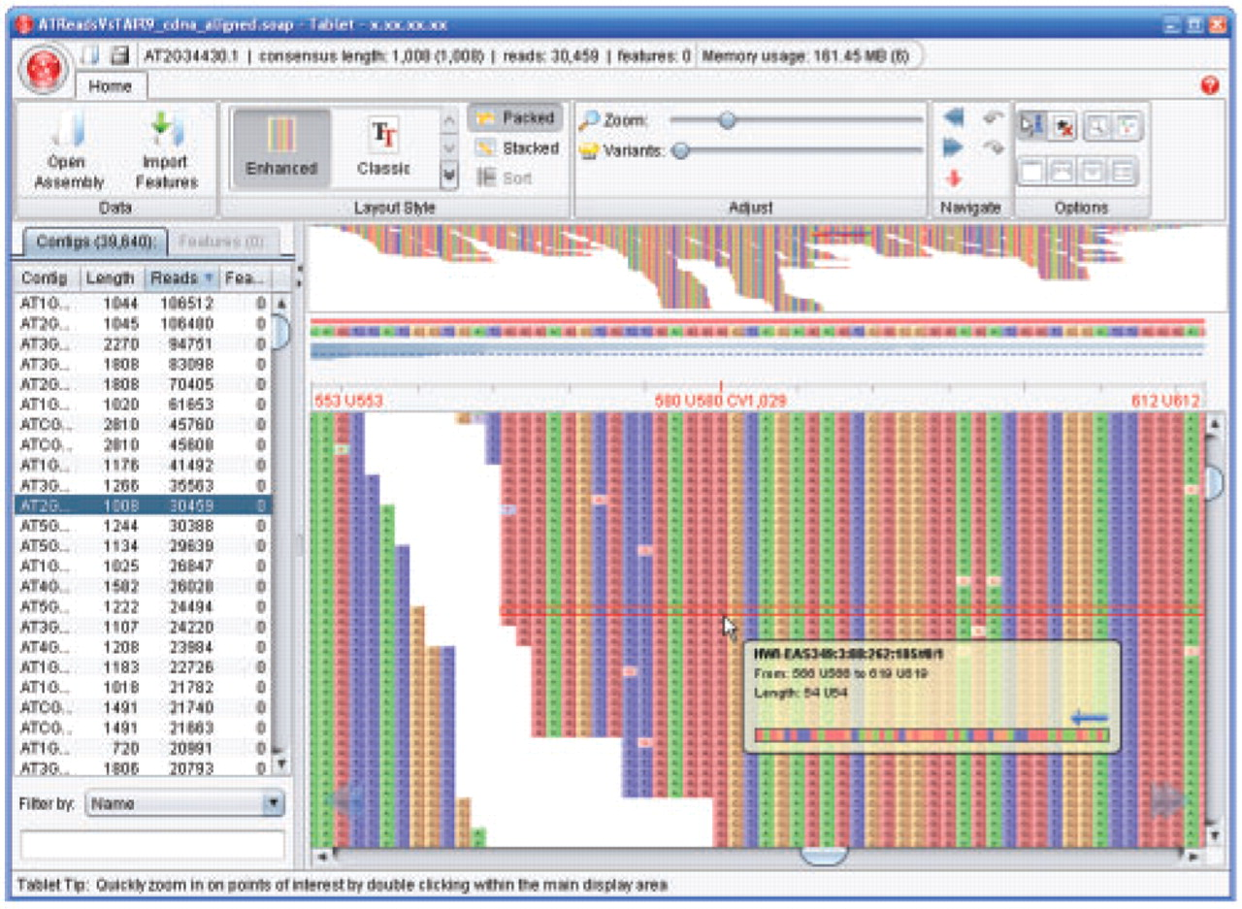

Slide 7
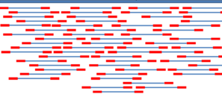
How to build a consensus
Several tools are available to derive consensus sequences from a SAM/BAM file:
mpileup
V-Phaser
QuasiBAM
Slide along the sequence, interrogating all reads covering each position
Mapping reference sequence
FASTQ sequences
Sliding window

Slide 8
How to build a consensus
Considerations
Quality of bases within a read
Phred score exclusion thresholds (usually 30, sometimes 20)
Quality of the read mapping
Map Quality exclusion thresholds
i.e. where the degree of homology to the reference sequence is low
Are these contaminants or rare sequence motif(s)?
Handling of insertions / deletions / variants
Can be very dependent upon choice of mapping software
Its parameters, and/or reference sequence

Slide 9
Variant calling – mpileup
mpileup (samtools) http://www.htslib.org/doc/samtools.html
Iterates through each position in a reference (i.e. one row per position)
Iterates through each read covering that position and adds a match type symbol…
. , Match to reference (forward & reverse respectively)
^ $ Start and finish of a read respectively
ACGTN, acgtn Mismatch to reference (fwd & rev respectively)
[+-][0-9]+[ACGTNacgtn]+ Insertions / deletions
…and a Quality symbol (Phred Score)

Slide 10
Variant calling – mpileup
1 215906528 G 21 ,,,,,,,,.,,,.,,..,.,, ;=?./:?>>;=7?>>@A?==:
1 215906529 A 18 ,,,,,,,,.,,,,,..,. D>AA:@A>9>?;;?>>@=
[...]
1 215906547 C 15 gGg$,GggGG,,.... <;80;><9=86=C>=
1 215906548 G 19 c$,ccC.,.,,,.,....,^. ;58610=7=>75=7<46;
[...]
1 215906555 G 16 .$aaaaaA.AAAaAAA^A 2@>?8?;<:335?:>
apprize.info

Slide 11
Variant calling – VCF
VCF “Variant Call Format”
http://vcftools.sourceforge.net
Developed for human genome annotations by 1,000 Genomes project
Useful for sparse variation in long, multi-chromosome genomes
Lists variations from a reference in a tabular format
One row per variant
(At least) 8 columns:
CHROM POS ID REF ALT QUAL FILTER INFO
CHROM = Chromosome
POS = Position
REF = Reference
ALT = Alternative (variant)

Slide 12
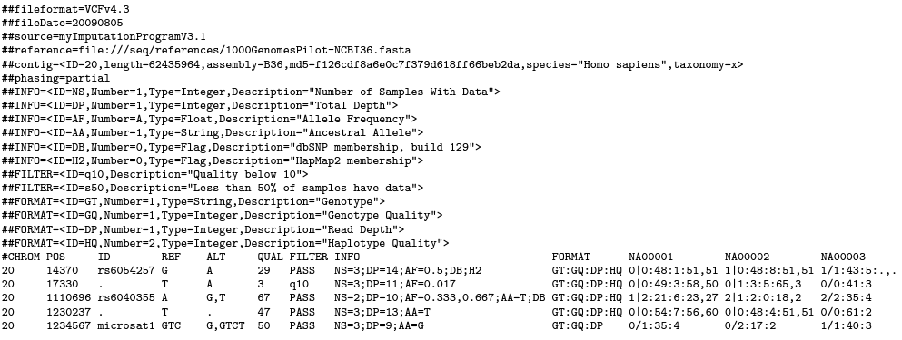
Variant calling – VCF
samtools.github.io

Slide 13
Variant calling – V-phaser
V-Phaser & V-Phaser 2
Developed by the Broad Institute
Considers read position, strand bias, quality scores, dinucleotide frequency, forward & reverse read, and phasing (linkage)
Reports variant frequency and absolute read numbers by forward & reverse read
Similar to VCF, but for viral populations
One row per variant
Seven columns:
Ref_Pos Var Cons Strd_bias_pval Type Var_perc SNP_or_LP_Profile
Macalalad AR et al. PLoS Computational Biology 2012 8(3):e1002417
Yang X, et al. BMC Genomics 2013 14:674

Slide 14
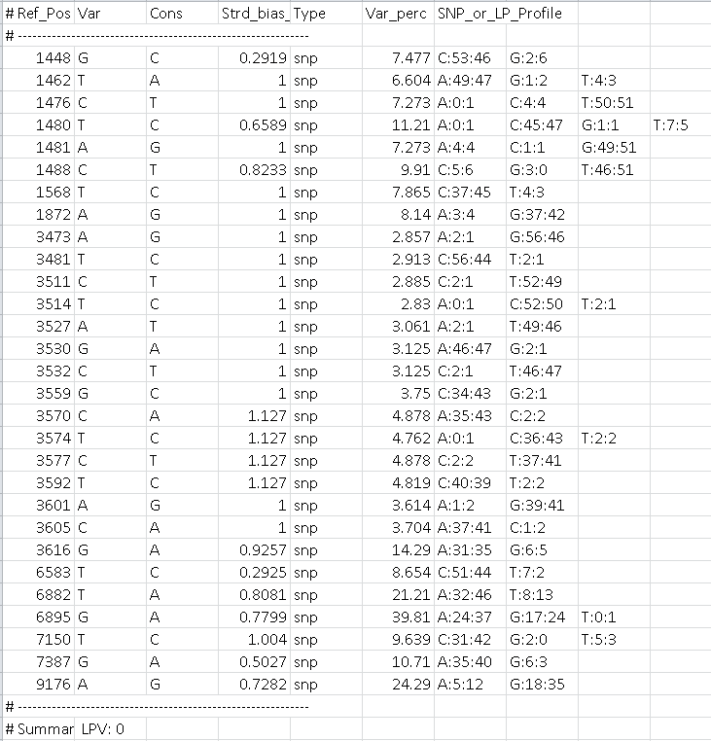
Variant calling – V-phaser

Slide 15
Variant calling – QuasiBAM
QuasiBAM (UKHSA)
Produces a table of nucleotide & codon frequencies for an entire reference
One row per nucleotide position, i.e. more like mpileup
14 Columns:
1-3 Position, Reference nucleotide, Depth
4-9 A / C / G / T / Gap / Insertion frequencies
10 Insertion sequences and their frequencies
11-12 Reference Amino Acid, Depth
13-14 Codon / Amino Acid frequencies
Can be parameterized
Strandedness
Gap-masking
Primer-mediated error filtering

Slide 16
Variant calling – QuasiBAM

Slide 17
Uses of variant analysis
Features
Typing
Resistance
Epitopes
Quasispecies reconstruction
Linkage
Dual infections
Transmission

Slide 18






Uses of variant analysis - Features
Here, the consensus can be submitted to ‘conventional’ tools for interpretation
Use the variant calling tool(s) to produce consensuses at different mixed-base thresholds to interrogate minority variants.
Validation, validation, validation

Slide 19
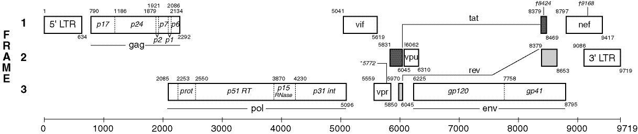
Uses of variant analysis - Quasispecies
Each read derives from an individual virus genome molecule
Linkage of variants on reads enables binning of haplotypes
Examine all reads that map across a short, specified region of the genome:
M 1
M 2
H 1
H 2
H 3

Slide 20
Uses of variant analysis - Quasispecies
Window of interest
GENOME

Slide 21
Uses of variant analysis - Quasispecies

Slide 22
Uses of variant analysis - Quasispecies

Slide 23
Uses of variant analysis - Quasispecies
x5
x1
x4

Slide 24
Uses of variant analysis - Quasispecies
Local data can be expanded to generate longer haplotypes
Haploclique https://github.com/cbg-ethz/haploclique
QuasiRecomb https://github.com/cbg-ethz/QuasiRecomb
QuRe https://sourceforge.net/projects/qure
PredictHaplo http://bmda.cs.unibas.ch/software.html
Efficiency of reconstruction is “varied”!
Beerenwinkel N et al. Front Microbiol. 2012 3:329
Prosperi MCF et al. Sci Rep. 2013 3:2837

Slide 25
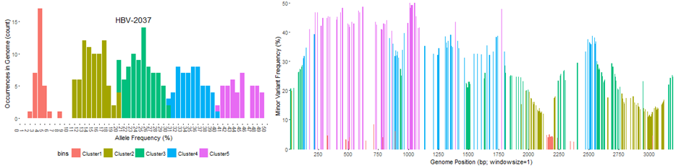
Uses of variant analysis - Quasispecies
Correlate mutation frequencies across the genome
Mathew Beale

Slide 26
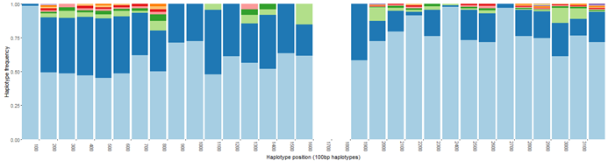
Uses of variant analysis - Quasispecies
Correlate mutation frequencies across the genome
Mathew Beale

Slide 27
Uses of variant analysis - Quasispecies
Correlate mutation frequencies across the genome
Mathew Beale

Slide 28
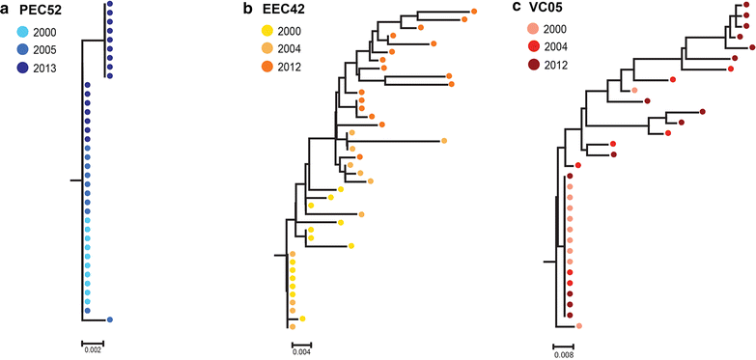
Uses of variant analysis - Quasispecies
de Azevedo SSD et al. Retrovirology 2017 14:29

Slide 29
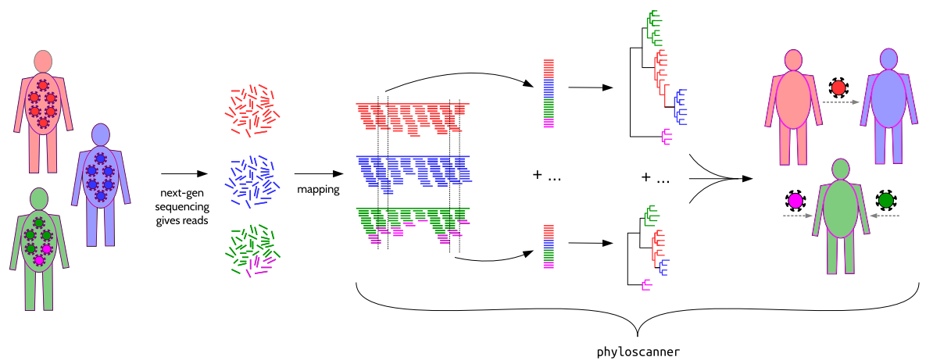
Uses of variant analysis - Quasispecies
Wymant C et al. Mol Biol Evol 2017

Slide 30
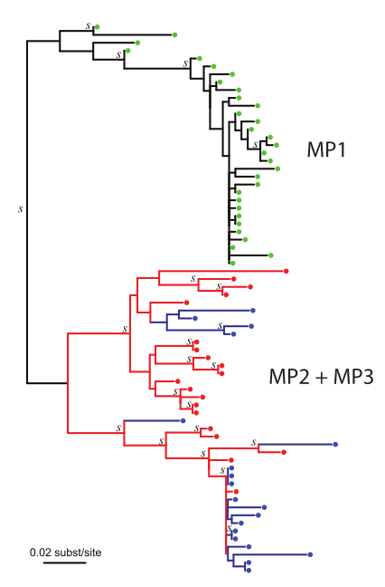
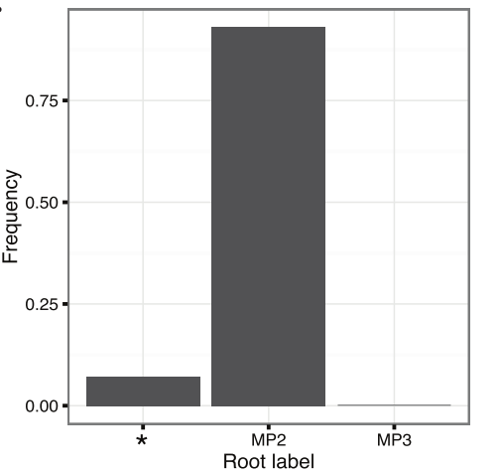
Uses of variant analysis - Quasispecies
Three patients – MP1, 2 & 3
Who infected whom?
MP1 is independent from the cluster
MP2 (red) → MP3 (blue)?
Or vice versa?
Romero-Severson EO et al. Genetics 2017 207(3):1089

Slide 31
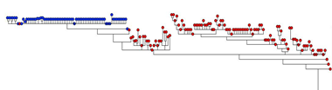
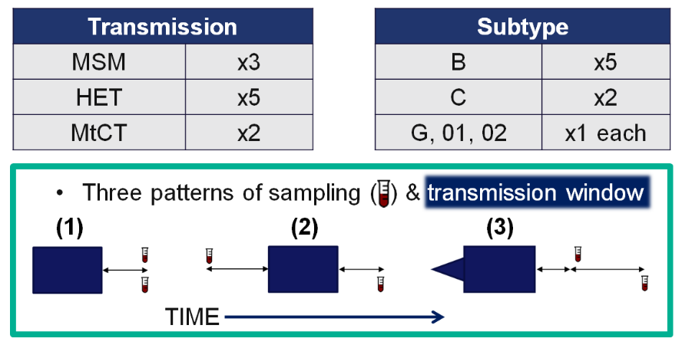
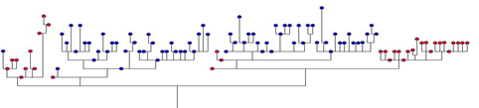
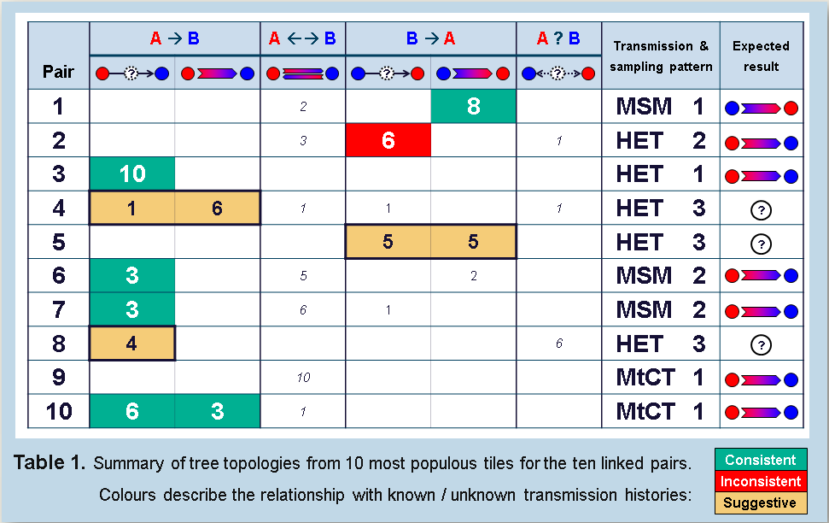
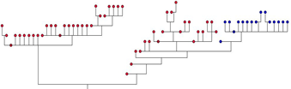
Uses of variant analysis - Quasispecies
Bibby DF et al. HIV Dynamics & Evolution 2017

Slide 32
Technical pitfalls
Frequency of minor variant detection limited by experimental noise
Many sources of error:
Sequencing
Amplicon-based sequencing
Nucleotide content
Hexamer priming
Product degradation
Contamination
Bioinformatics

Slide 33
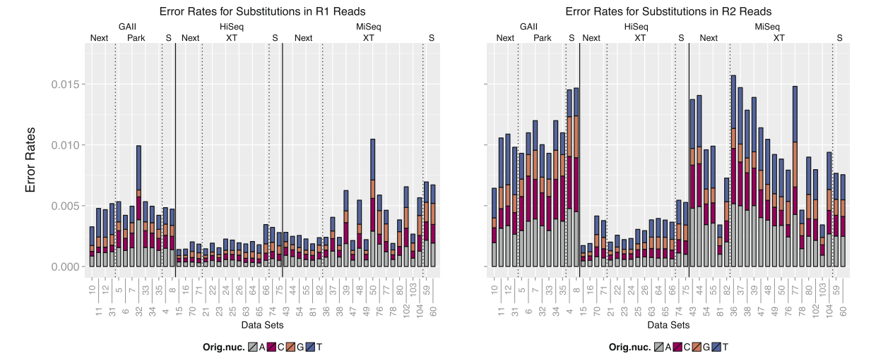
Technical pitfalls – Sequencing
Schirmer M et al. BMC Bioinformatics 17(1):125

Slide 34
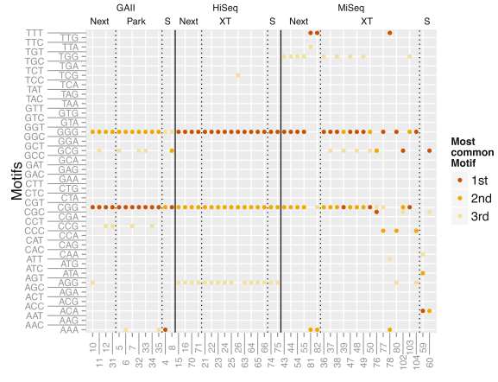
Technical pitfalls – Sequencing
Substitutions
xGG motif
GGG = CGG > AGG > TGG
Schirmer M et al. BMC Bioinformatics 17(1):125

Slide 35
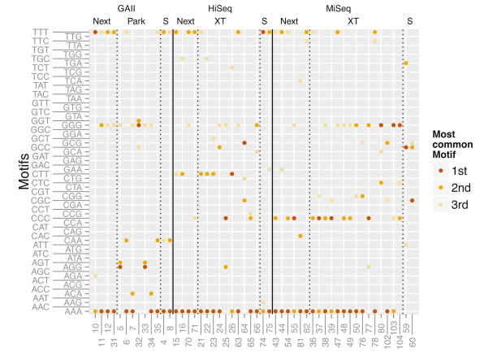
Technical pitfalls – Sequencing
Indels
Homopolymeric tracts
AAA > CCC = GGG = TTT
High Quality Scores
Schirmer M et al. BMC Bioinformatics 17(1):125

Slide 36
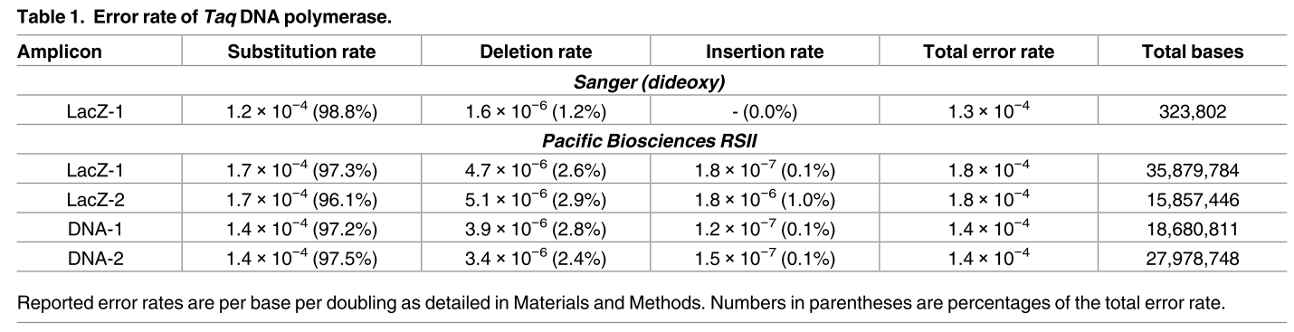
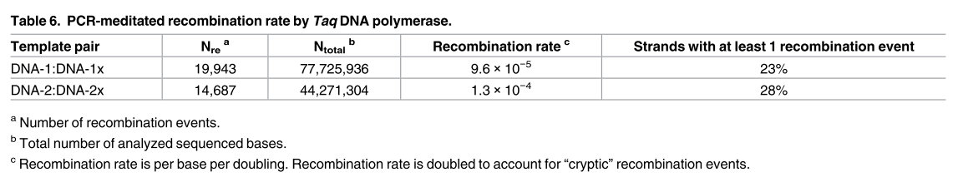
Technical pitfalls – Amplicons
1kb, 16x cycles
Potapov V et al. PLoS One 2017 12(1): e0169774

Slide 37
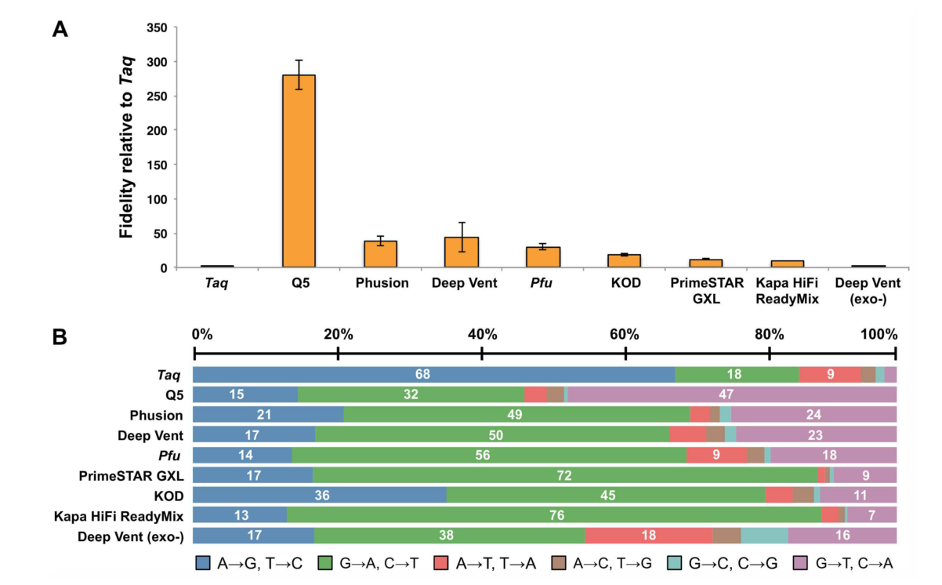
Technical pitfalls – Amplicons
Potapov V et al. PLoS One 2017 12(1): e0169774

Slide 38
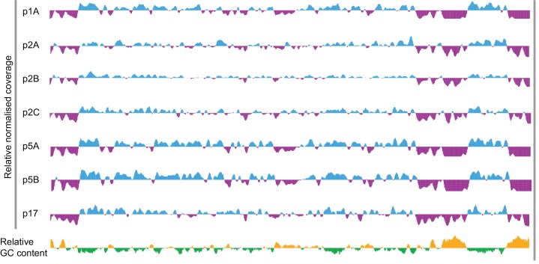
Technical pitfalls – Nucleotide content
Karamitros T et al. PLoS One 2016 11(6):e0157600

Slide 39
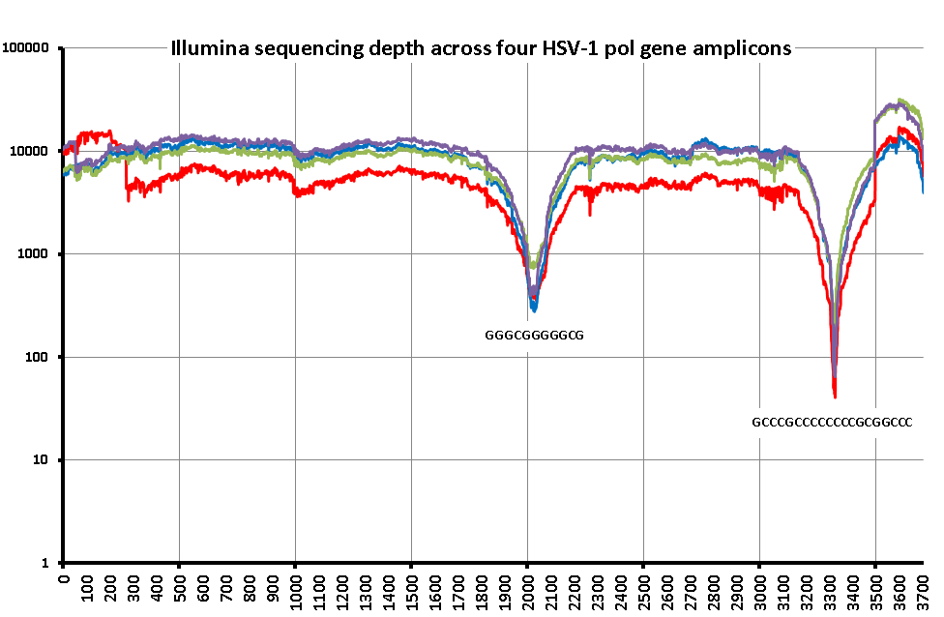
Technical pitfalls – Nucleotide content
UKHSA (unpublished)

Slide 40
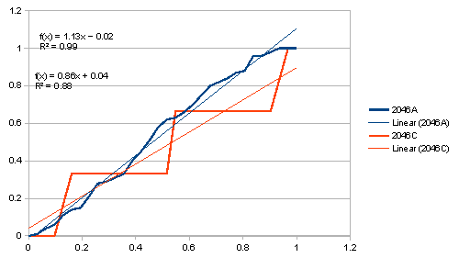
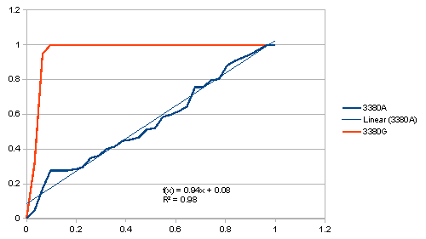
Technical pitfalls – Hexamer priming
The position of the minority variant nucleotide (red line) is evenly distributed along the read lengths
(as is the majority variant in blue)
100% of the minority variants are within 7% (10nt) of a read terminus – artefact from insert-priming
UKHSA (unpublished)

Slide 41
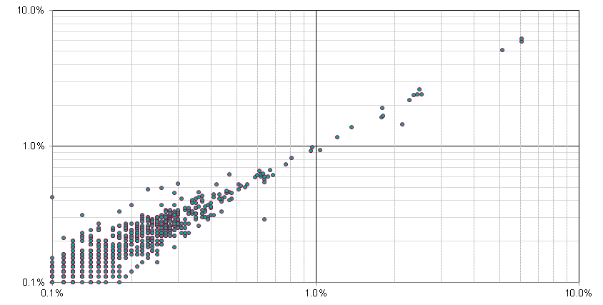
Technical pitfalls – Product degradation
UKHSA (unpublished)

Slide 42
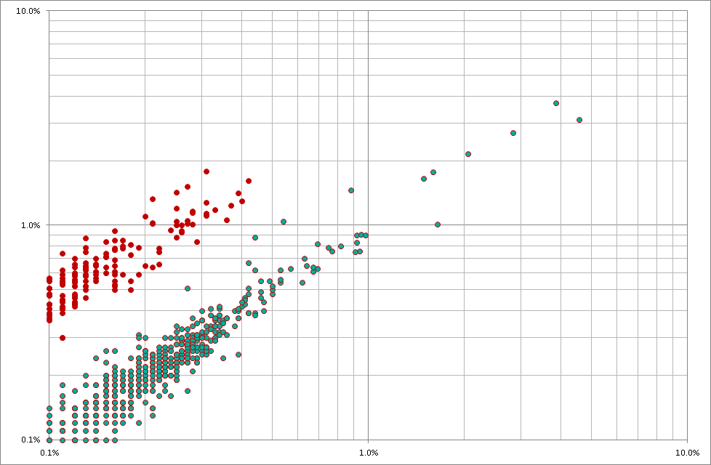
Technical pitfalls – Product degradation
UKHSA (unpublished)

Slide 43
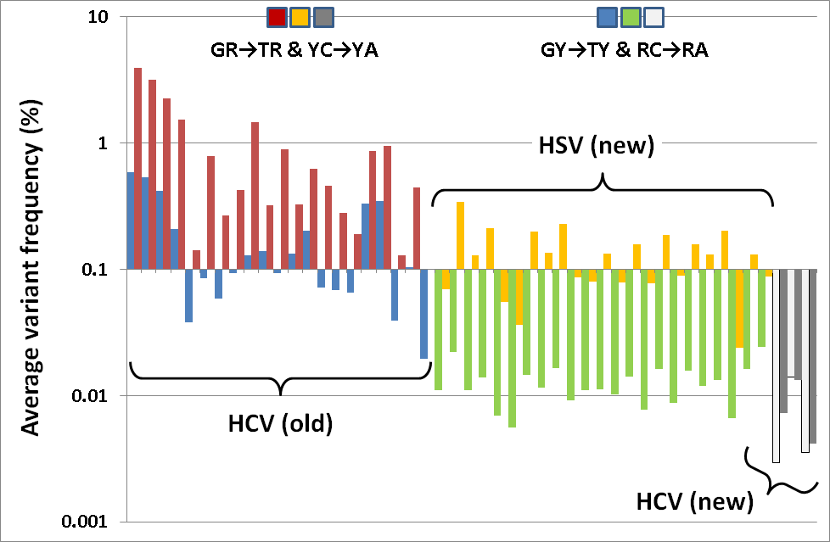
Technical pitfalls – Product degradation
Much investigation revealed context-specific conversion of dinucleotides
YC → YA
GR → TR
The frequency of converted bases is proportional to the time spent at 4ºC
previously only seen in sonicated fragments – Costello et al. NAR 2013
UKHSA (unpublished)

Slide 44
Technical pitfalls – Contamination
“Sequences not belonging to that sample present in the FASTQ set”
Index-switching
Occurs during library prep / sequencing
Laboratory contamination
Similar to PCR
Spatial and temporal separation of work areas
Rotation of adapters
Robotics
Rotation of control positions
Alternation of template types

Slide 45

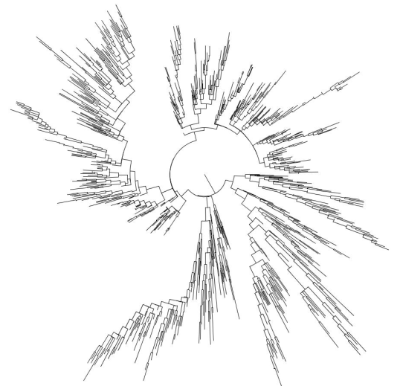
Technical pitfalls – Bioinformatics
Synthetic FASTQ datasets
HIV quasi-species generation
Adapted from Pandit A & de Boer R, Retrovirology 2014 11(1):56
FASTQ generation using empirical error profiles / quality scores
ART - Huang W, et al. Bioinformatics 2012 28(4):593-4
Two pre-production pipelines tested

Slide 46
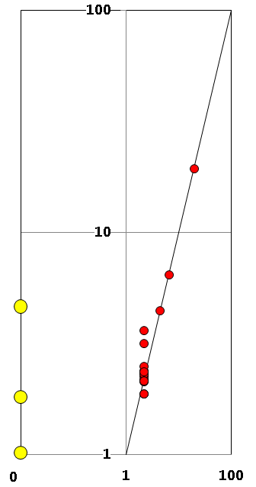
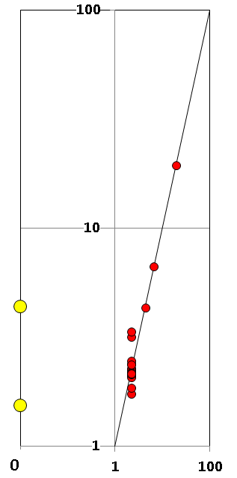
Technical pitfalls – Bioinformatics
Reported frequency
False +ve
Expected frequency
UKHSA (unpublished)

Slide 47
Validation
Sample type
Extraction
(RT)
(PCR)
REPORTS
Library prep
Interpretation
Bioinformatics
Sequencing

Slide 48
Validation – How low can you go?
For HIV & HCV, Sanger at 15-20% == resistant
What does 10% mean?
5%?
Reproducibility, repeatability, accuracy and precision is critical
Validating against Sanger is relatively straightforward, both clinically and technically
Validating lower frequencies is quite the opposite
Clinical utility of lower frequency variants unproven
Cut-offs vary considerably between assays

Slide 49
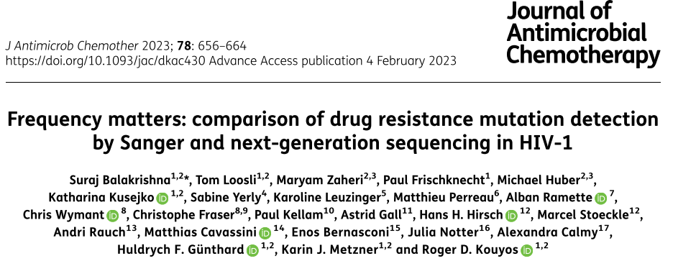
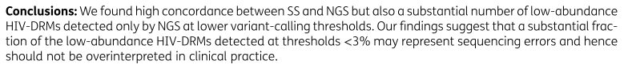
Validation – How low can you go?

Slide 50
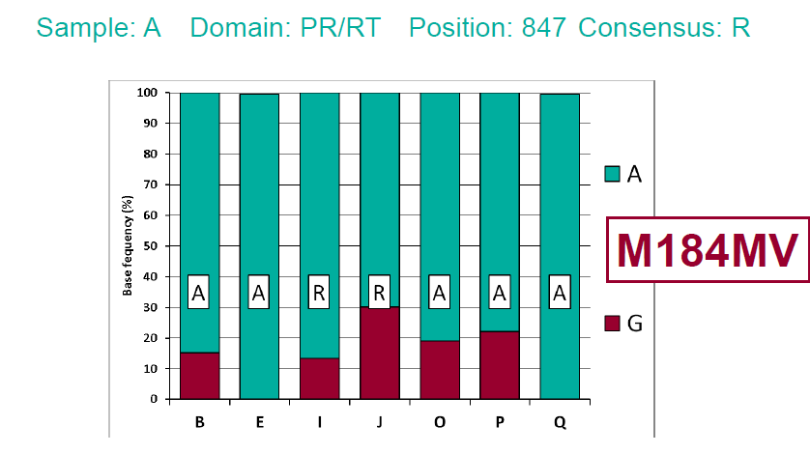
Validation – Copy number & variant frequency
How reliable is a variant frequency call?
When the depth of coverage (i.e. reads covering that position) is high/low?
What levels constitute ‘high’ and ‘low’ depths for PCR, sequence capture and metagenomic approaches?
ATG
GTG
RTG
UKHSA (unpublished)

Slide 51
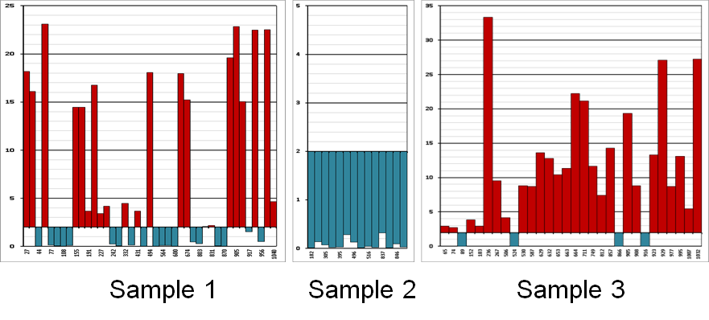
Validation – Copy number & variant frequency
How reliable is a variant frequency call?
When the depth of coverage (i.e. reads covering that position) is high/low?
What levels constitute ‘high’ and ‘low’ depths for PCR, sequence capture and metagenomic approaches?
UKHSA (unpublished)

Slide 52
Validation – Copy number & variant frequency
How reliable is a variant frequency call?
PCR produces large amounts of material
How representative of the starting population is the amplicon mix?
Depth is not correlated with reliability!
If the starting virus copy number is 100,000 copies per library, 10% = 10,000
But at 1,000 copies, how reliable is 5% (50 viruses)?
Reverse transcription (to generate cDNA) is notoriously inefficient and error-prone – how many viruses are represented?
There are multiple PCR cycles in the library prep too...
Often, the amount of starting material / viral load is unknown

Slide 53
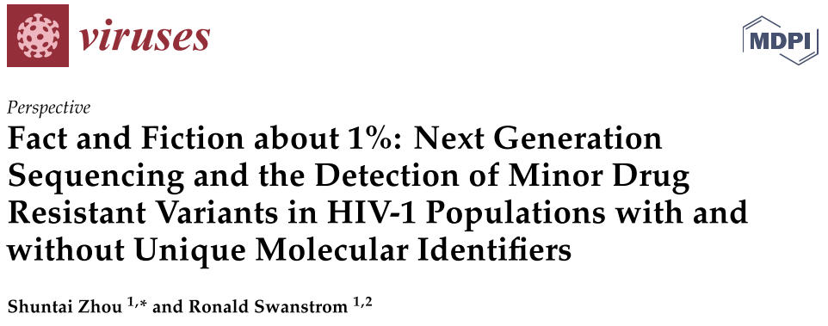
Validation – Copy number & variant frequency
Viruses (2020) 12(8): 850

Slide 54

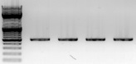
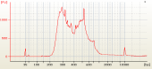

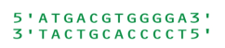
Validation – Standardised materials
Sample – haplotypes mixed at precise frequencies (e.g. 1, 2, 5, 10 & 20%)
DNA / RNA extract
PCR product
Library – storage issues
FASTQ datasets - artificial quasispecies and synthetic FASTQs
Consensus sequences – to test interpretation mechanisms

Slide 55
Summary
Consensus & variant calling
Many tools for mapping (BWA, Bowtie, smalt, Tanoti)
Several tools for variant calling (QuasiBAM, V-Phaser)
Choice of reference & user-defined parameters is CRITICAL
Using the consensus
Submit to usual tools
Different mixed-base thresholds to incorporate minority variants
BEWARE – Interpretations may not be validated on NGS-derived data...
Phyletic analysis is coming

Slide 56
Summary
Technical pitfalls
Experimental approach influences the result in unpredictable ways
Low-frequency variation can arise through diverse processes
Reproducibility experiments are essential
Across a range of conditions and samples
Validation
ESSENTIAL – especially when detecting ‘new’ data, e.g. <20% minority
All components of the assay need independent investigation
Look at all the data
ESPECIALLY THE BIOINFORMATICS!

